Slide 1



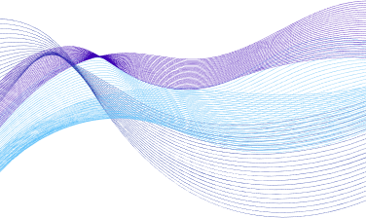

KubeSecure
AI-Driven Anomaly Detection in Kubernetes Cluster
Muhammad Hani
I21-2595
M. Usman Azam I21-0653
Dr. Arshad Islam
Supervisor
Daniyal Ahmad
I21-2493

Slide 2

Project Overview
Monitoring Challenges
01
Sophisticated Threats
02
In-Time Network Anomaly Detection
03
Automated Response Mechanism
04
YAML Misconfiguration Detection
05

Slide 3
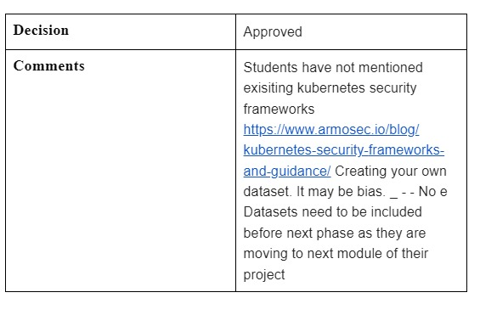
Proposal Defense Feedback
Self made dataset will be biased so we are not making it.

Slide 4

Functional Requirements
Anomaly Detection
Traffic Analysis through Deep Learning model
Automated Threat Mitigation
Honeypot for Traffic Analysis
YAML File Misconfiguration Check
Admin Panel

Slide 5
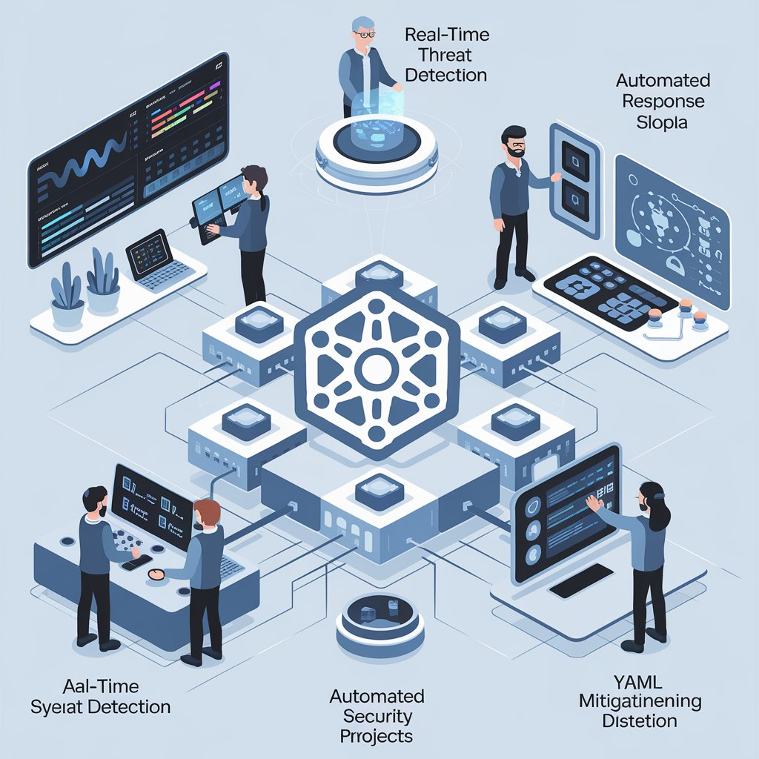
Non-Functional
Requirements
User-Friendly
In-Time Data Processing
Scalability
Reliability
Interoperability
Security
Notes:
We will have a user friendly website for admins. Our Model will process data with minimal delay and it will be scalable in case of high volumns of traffic. It will also be reliable with minimal failover time of pods. Moreover, it will be compatible with existing and upcoming Kubernetes tools. Our Deep learning model will not be accessbile publically so prevent unauthorize access.

Slide 6
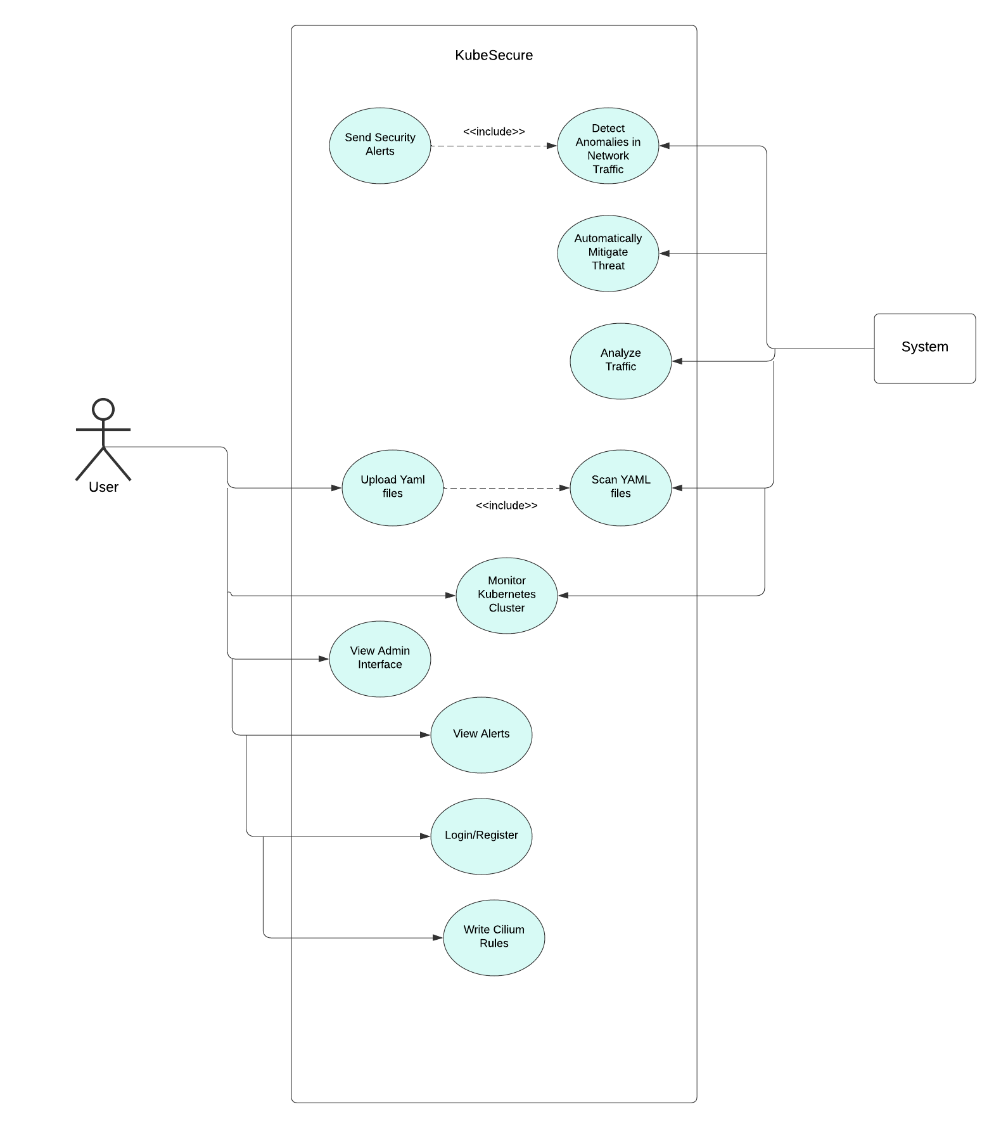

Use Case
Diagram

Slide 7
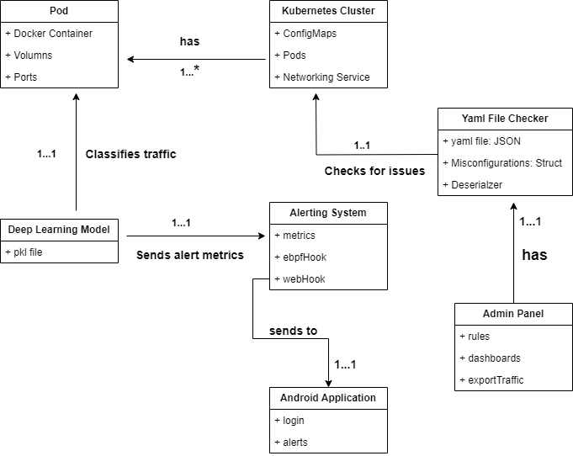
Domain
Model

Slide 8
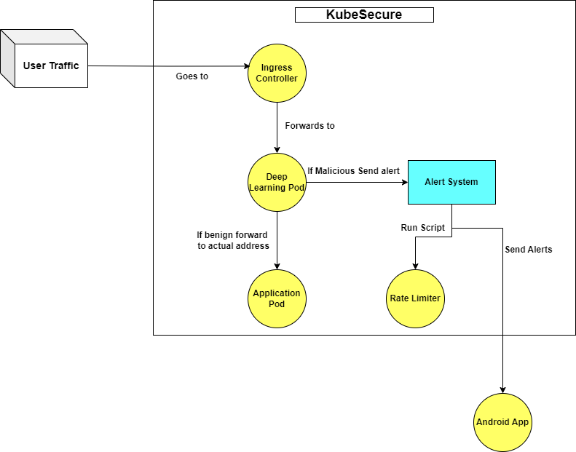
Data Flow
Level 01

Slide 9
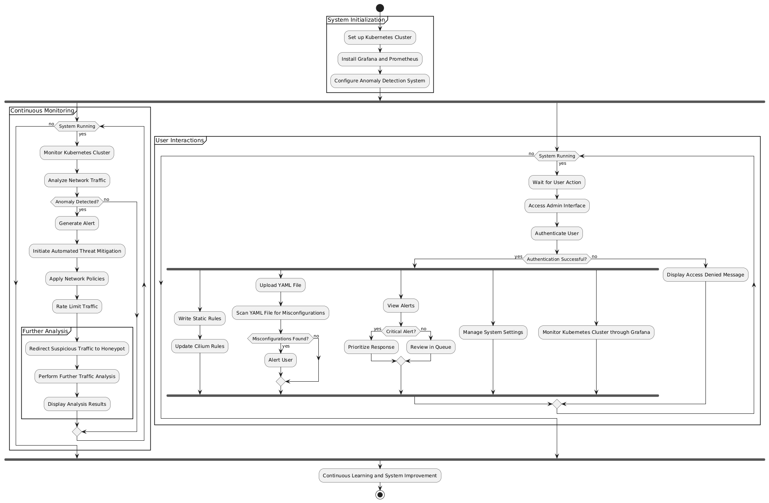
Activity
Diagram

Slide 10
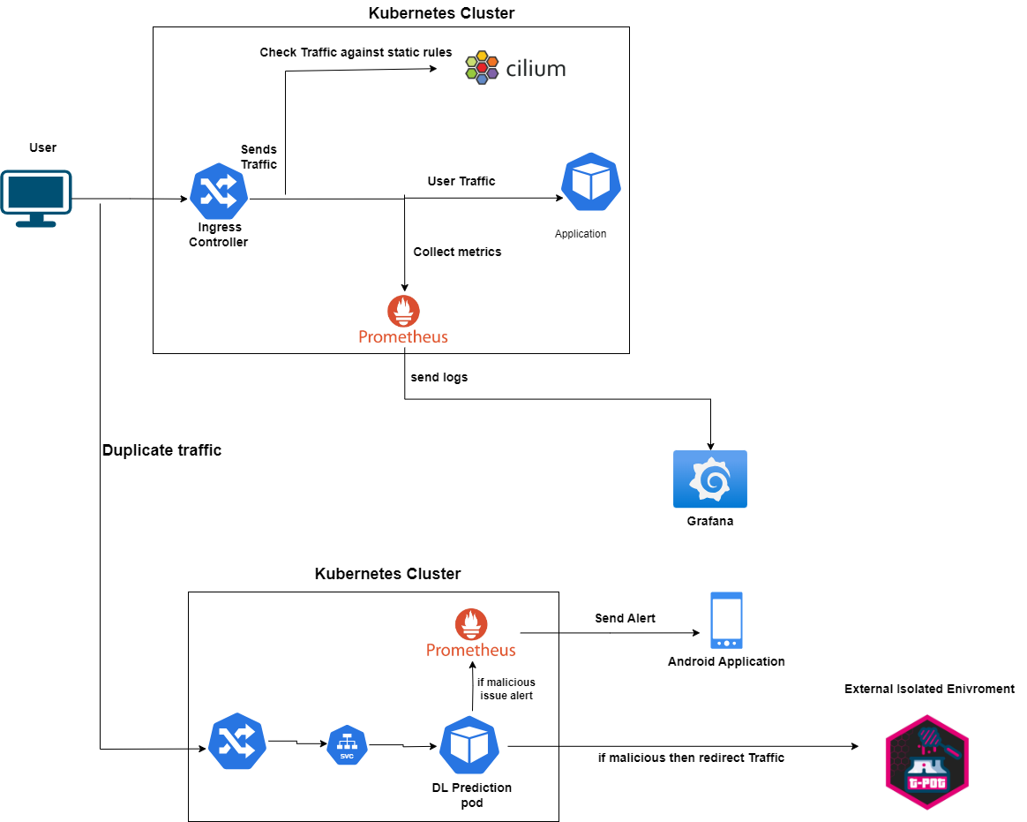
Architecture
Diagram

Slide 11
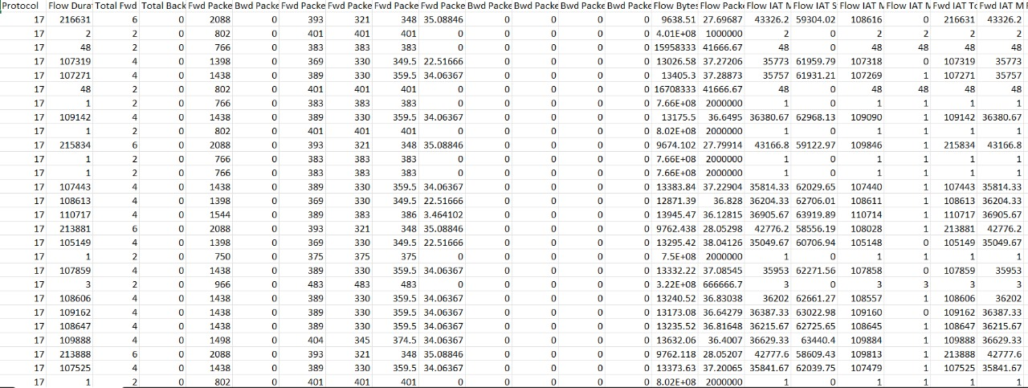
Dataset

Slide 12
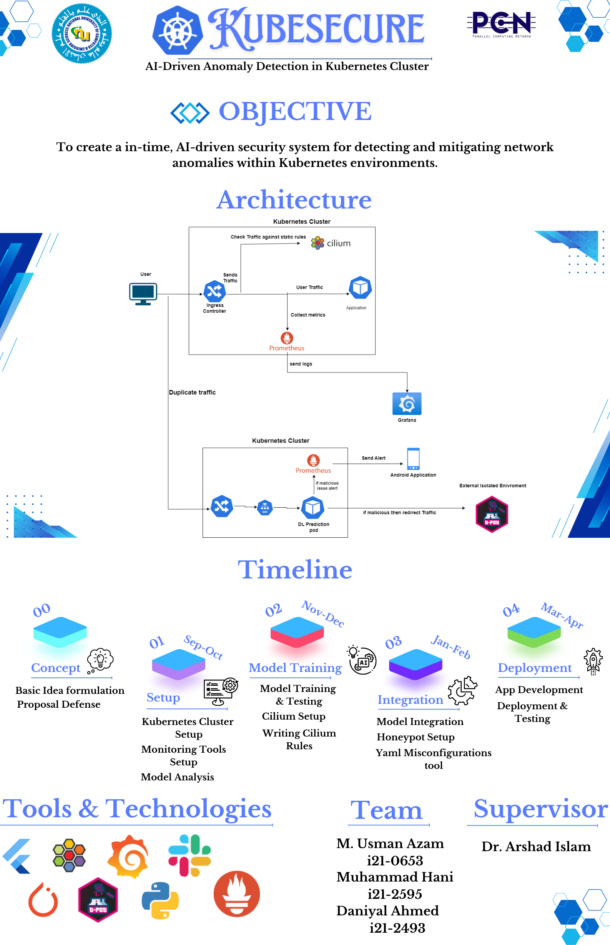
Poster

Slide 13
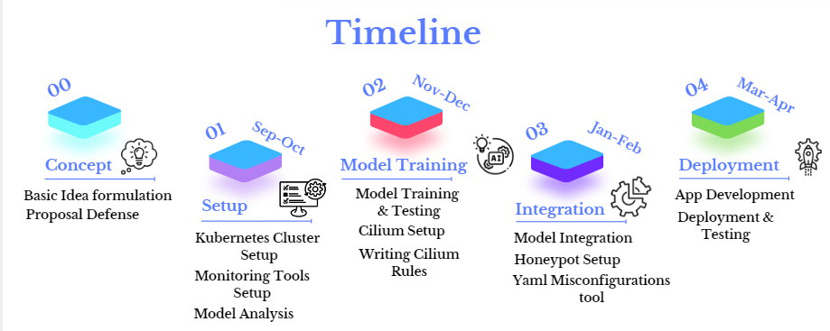

Slide 14
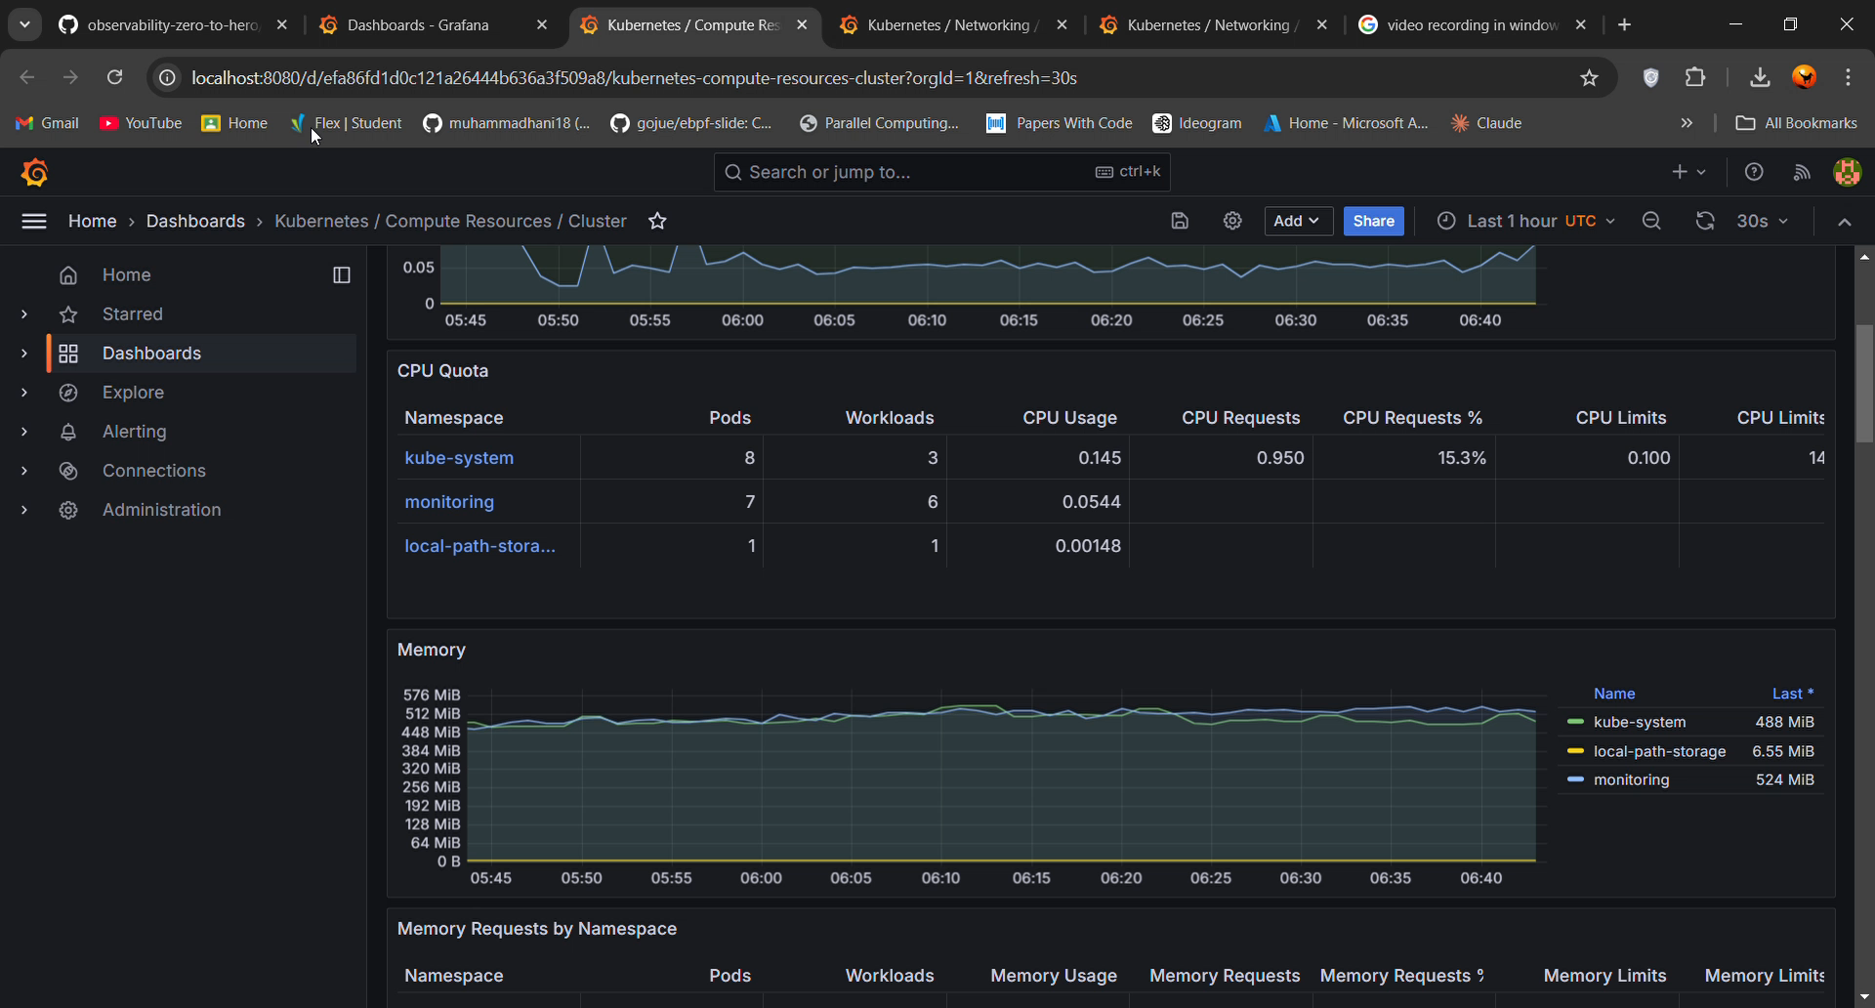
Iteration 1 work so far

Slide 15
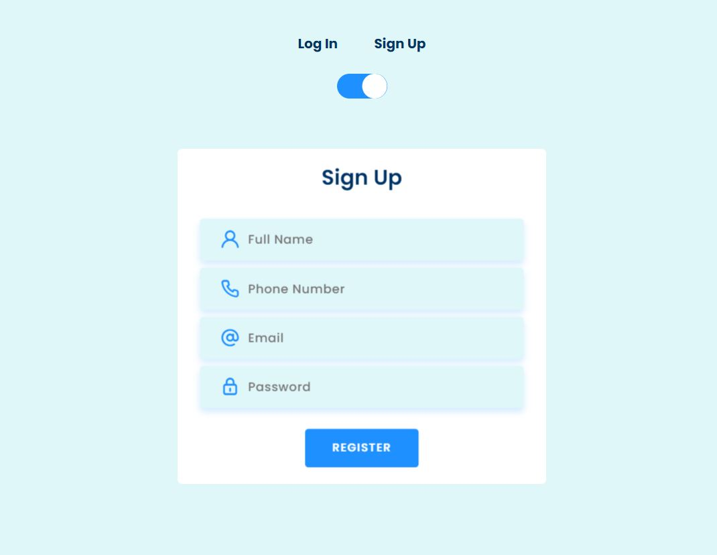
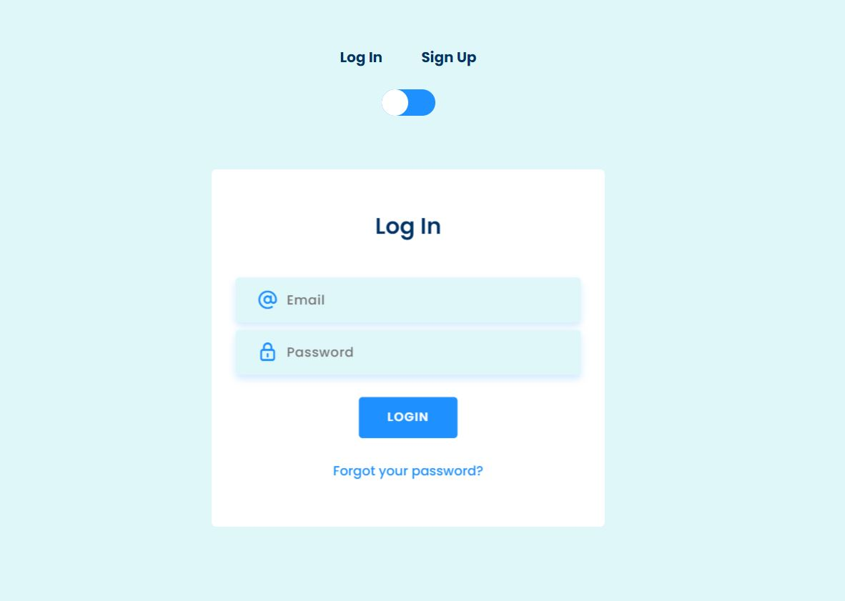
Iteration 1 work so far

Slide 16
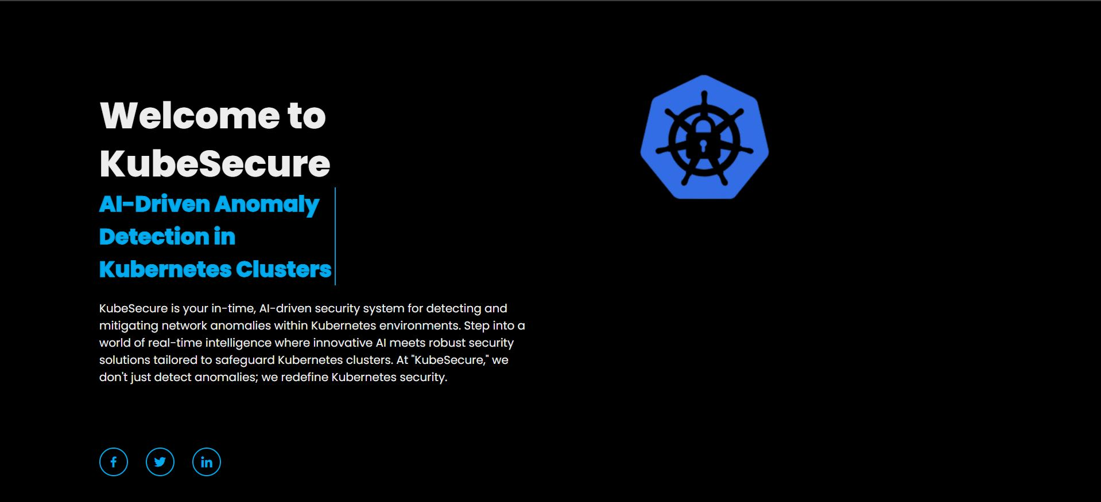
Iteration 1 work so far

Slide 17
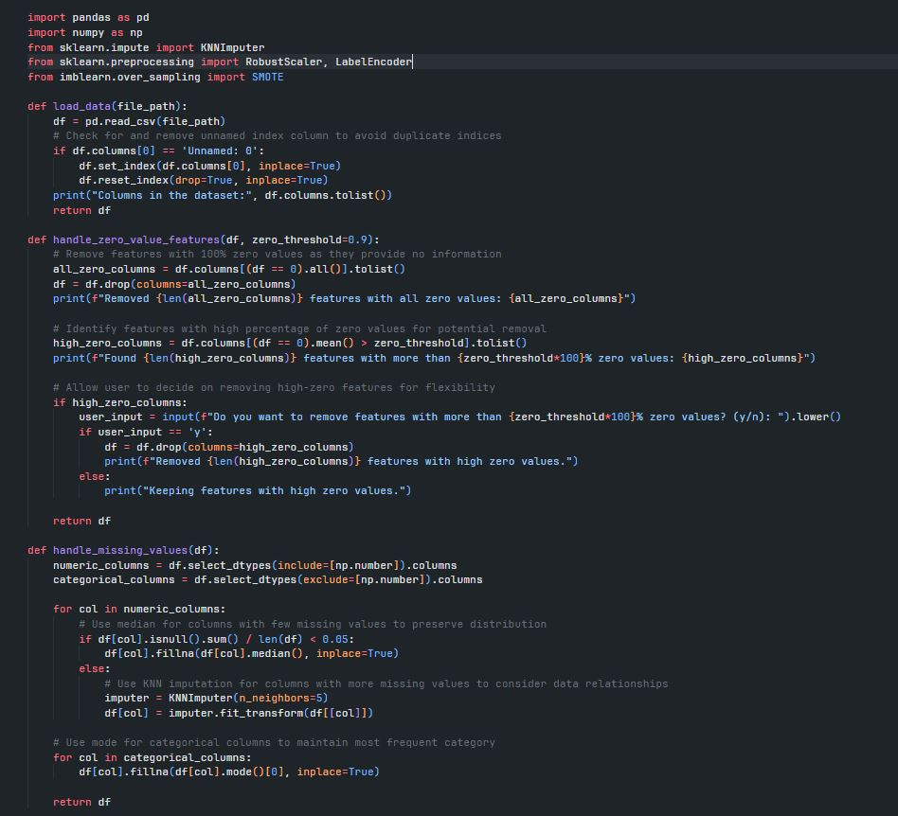
Iteration 1 work so far

Slide 18
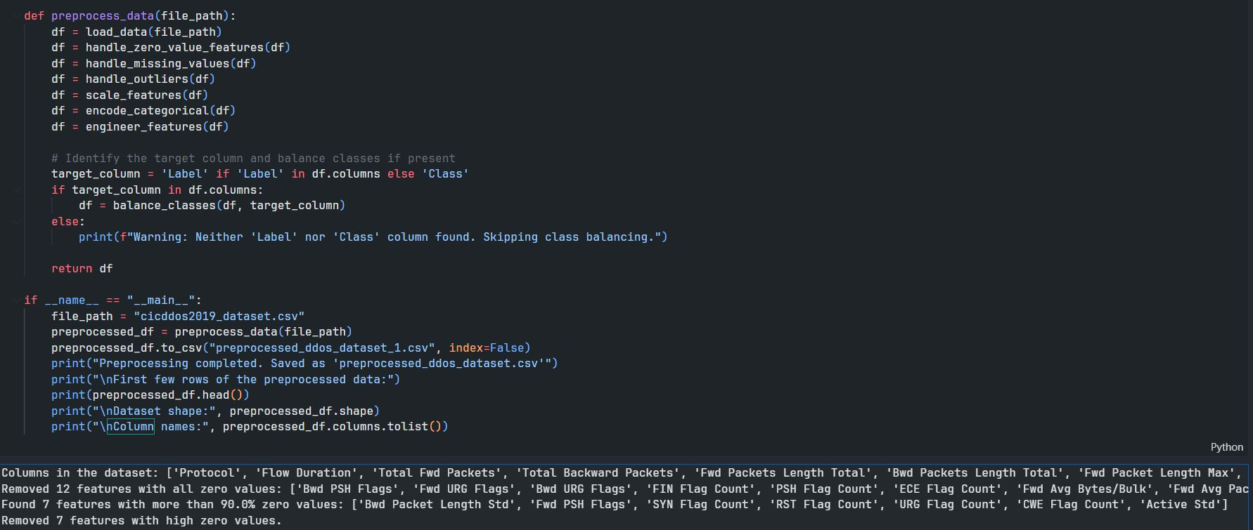
Iteration 1 work so far

Slide 19
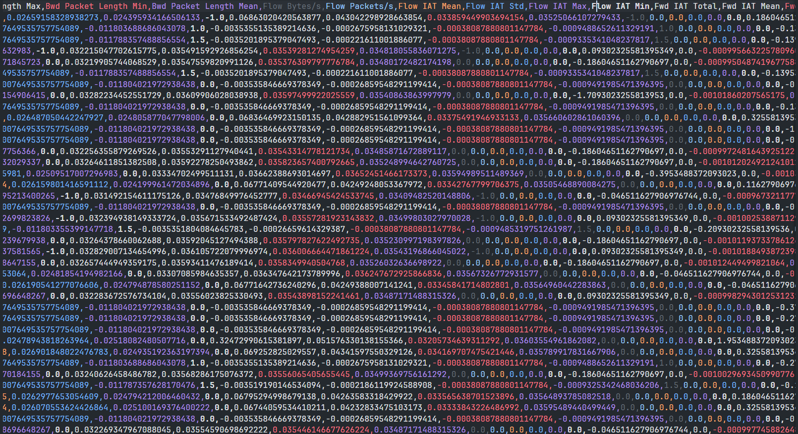
Iteration 1 work so far

Slide 20
Thank You
Live Demo

Slide 21
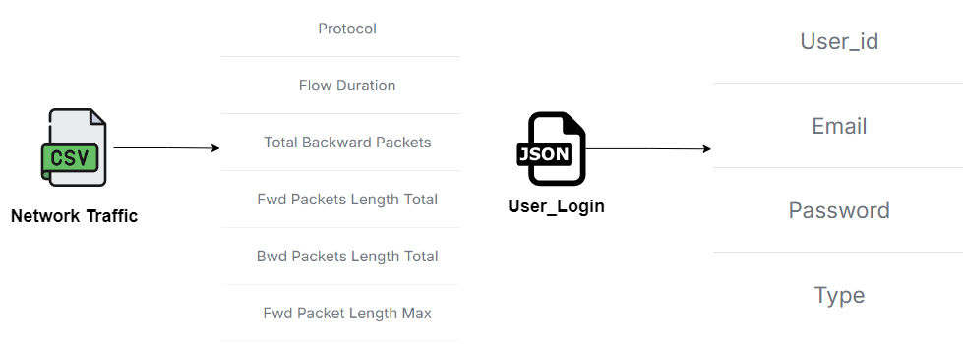
JSON
Schema

